Slide 1

Project Synopsis
on
INSTITUTE SEARCHER
SUBMITTED BY:
1. Jayant Singh Jhala
20CS002272
2. Nitesh Agrawal
20CS002278
B.Tech(CSE AI&ML) 4th Sem
SUPERVISED BY:
Dr. Amit Jain
Assistant Professor
(School of Engineering)

Slide 2
Introduction
It is undoubtedly true that college education is an investment, whereby the student together with their parents spent money, time and energy for years with the intention that this ‘intellectual’ investment would be profitable.
Therefore, the people take huge interest in knowing where the top institutes stacks up in comparison to the other Institutes, therefore making the Institute ranking useful to many people.

Slide 3
Introduction (Cont’d)
Thereby, there are various software to choose from, most of which are hard to navigate and with ton of confusing and irrelevant data.
Whereas, our software serves with as basic as possible navigation options made available in one single system.

Slide 4
Current System
Today, there are several well-known National ranking lists for ranking Institutes in India. While some of them ranked a enormous amount of thousands of best and most influential institutes as claimed by those sites.
those include a much larger number of ranking scientific institutions.
In such a complex IT system of exploring an extremely large number of institutions, this system shows some disadvantages by being less user friendly and moreover confusing.

Slide 5
Current System (Cont’d)
Which of course can be overcome by introducing certain improvements within the system of exploring the options.
Among other things, we will consider the possible solutions which would improve the and prevent possible confusion among the user

Slide 6
Proposed System
For an analysis of the system of exploring of Institutes, Institute Searcher, the most important parts of it’s methodology would be providing user with ability to search through various top institutions in India, with help of ample amount of search options available.
i.e., A survey of ways in which relevant information, for e.g. Scores, their rankings etc. that are obtained by the ranking process of Institutions according to the National Institution Ranking methodology may be obtained.

Slide 7
Proposed System (Cont’d)
This System serves as a corrective to the national evaluation of a wide range of Institutions in India.
Our System performs the collection, analysis of data and Feed that data into a pre-structured database.
Then as per the user requirement it searches the specific results using very basic although easy to redraft programming framework.

Slide 8
Hardware Requirements
 | MINIMUM | RECOMMENDED
CPU | 64bit x64 CPU | Multicore 64bit x64 CPU
RAM | 4 Gigabytes | 8 Gigabytes
DISPLAY | 1024x76 | 1920x1200

Slide 9
Software
Requirement
Windows 7 or Later (64-bit)
Python 3.9(Recommended)
MySQL 8.0.28 or Later

Slide 10
Relationship Chart
Institute ID
Name of Institution
Rank
Institute Searcher
City
Score
State

Slide 11
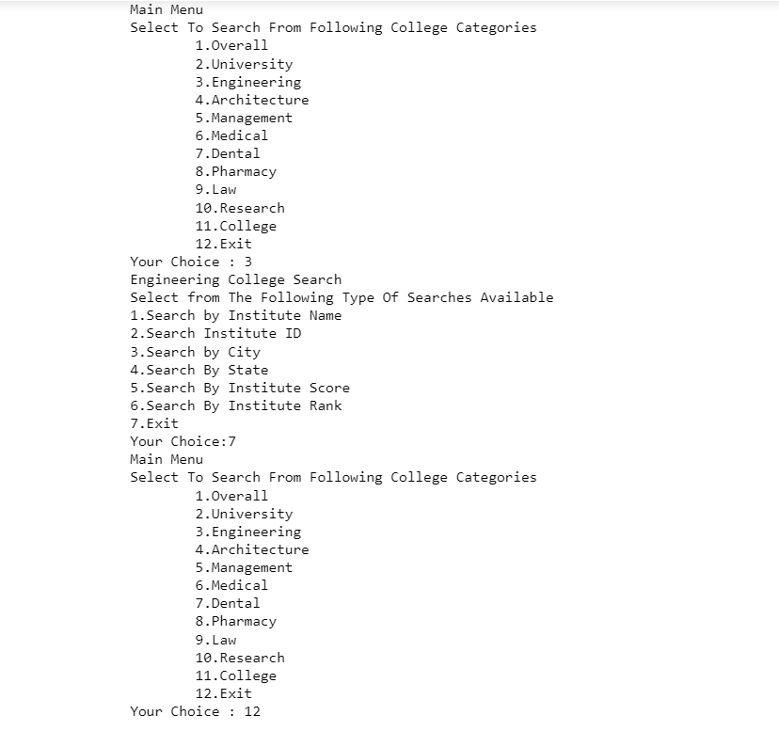

Slide 12
Literature
During the past several decades, “ranking system” became an important factor of the way to measure people’s success or failure in India.
As people know, institute searching can provide more information to student and their parents. Also, institution searching make students be able to consider their future Institute based on the facts they need. Those data of institution rankings are collected by trustable survey agencies, independent third parties, or Government agencies such as NIRF. Therefore, the resources of the based information are trustworthy.

Slide 13
Literature (Cont’d)
Various rankings mostly evaluating on institutional output by research. Some rankings evaluate institutions within the country, while others assess institutions worldwide. The subject has produced much debate about institute exploration’s usefulness and accuracy.
Institution Searching helps students, parents, and education industry organizations who are looking for details on the higher education sector in India. It provides relevant information about courses, ranking of different Institutes, admission procedure for different courses and much more. To help students who give various competitive exams like NEET, JEE Main etc. to select the best colleges.

Slide 14
Timeline
January:
Institution data Collection
Cleaning of Data
February & March:
Collection of required programming knowledge
Writing the required code with revisable functions
debugging alongside programming the system

Slide 15
Timeline (Cont’d)
April:
Removing possible unnoticed flaws in the code
Final compilation of the Package
May:
Final Submission Of the Project

Slide 16
References
https://www.nirfindia.org/2021/Ranking.html
https://www.geeksforgeeks.org/
https://www.javatpoint.com/
https://github.com/

